Slide 1


Geog4300 Final
Geog4300: Shannon

Slide 2
Today’s agenda
Reviewing course topics
Final presentations
Final thoughts on the class
Notes:
Alternative hypothesis is usually what you’re trying to prove.

Slide 3

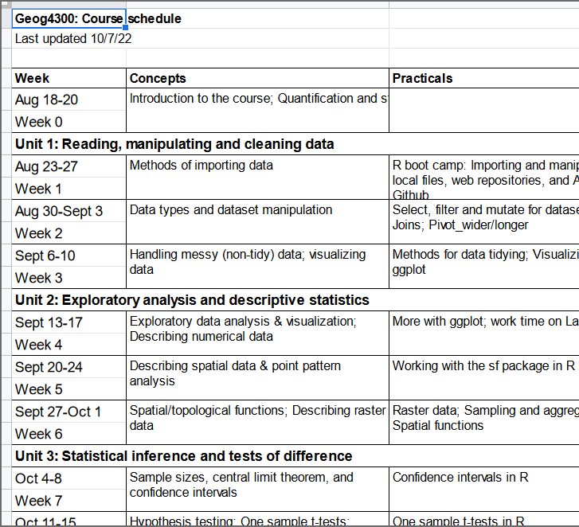
Let’s review! What topics and techniques have we covered?
Notes:
Alternative hypothesis is usually what you’re trying to prove.

Slide 4
What were the three most important topics? Why?
Notes:
Alternative hypothesis is usually what you’re trying to prove.

Slide 5
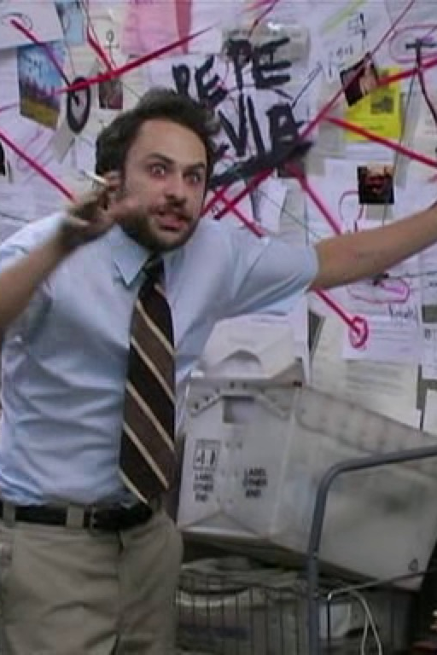
Final presentations
Notes:
Alternative hypothesis is usually what you’re trying to prove.

Slide 6
Final thoughts
What do you wish we had spent more time on this semester?
What will you still remember in six months?
What changes should I make next time?
Notes:
Alternative hypothesis is usually what you’re trying to prove.

